Slide 1

OTOMOTO CAR PRICE PREDICTION
SUBMITTED BY : AMEYA PRASANNA MOTE

Slide 2
INDEX :
Aim
About dataset
Import necessary packages
Basic pre-processing
Exploratory data analysis
Detection and removing outliers
Feature scaling
K fold cross validation
Support vector regression
Convolutional neural network
Polynomial regression
Random forest regression
Model performance
Conclusion
Further actions
Xg Boost Regression

Slide 3
AIM:
To find the discrepancies in data.
To find relationship across various factors.
To pre-process the data and remove outliers.
To gather the best model performance.
Compare models with various performance Metrics.

Slide 4
ABOUT DATA SET:
This dataset contains the different car manufacturers along with its manufacturing year
In the form of continuous data , we have mileage ,engine power and engine capacity.
The categorical columns consist of gear box , fuel type, car damaged or not and the status of the seller.
Lastly, the target column is aptly named target_price.

Slide 5
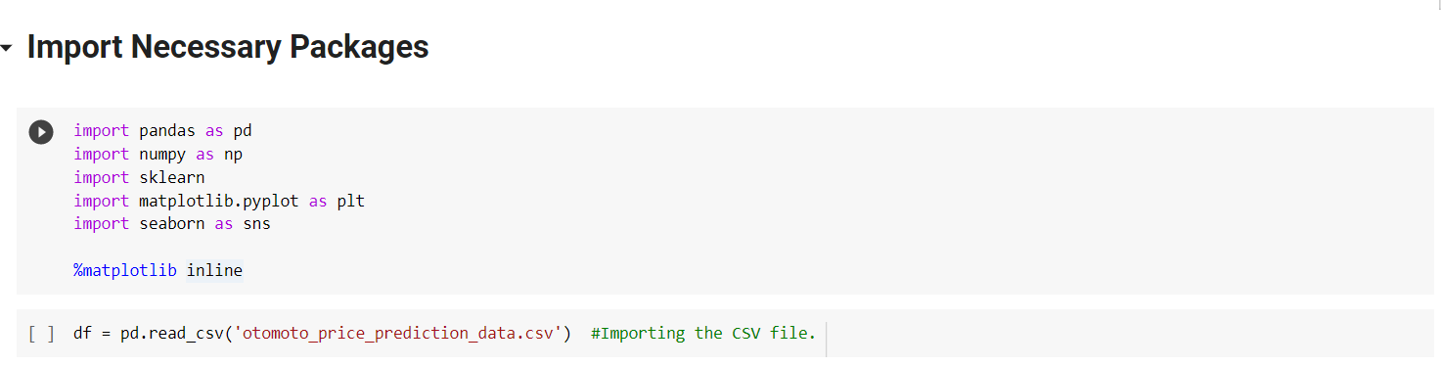
IMPORT NECESSARY PACKAGES:
We used pandas to convert the csv file for processing.
NumPy was initialized for various reshaping needs and treating outliers.
Sklearn as we all know houses many levels of different machine learning models .
We employed matplotlib and sea born for plotting the graphs and other visualization processes.

Slide 6
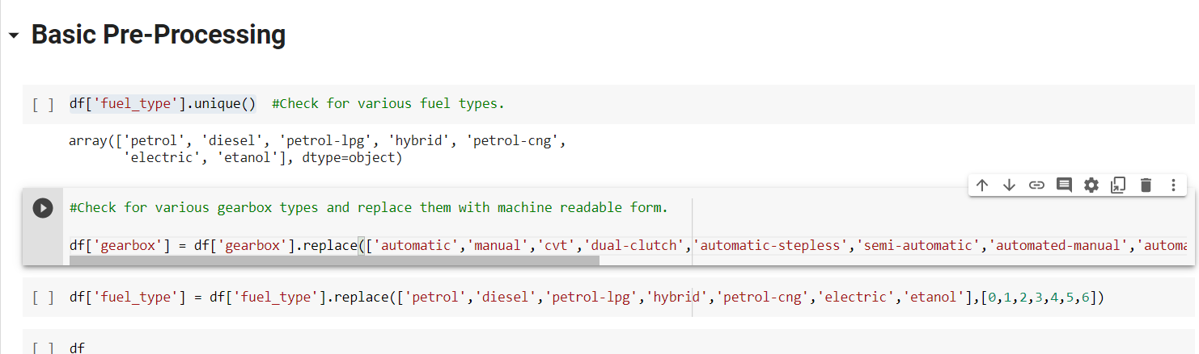
BASIC PRE-PROCESSING:
We converted the gear box column and the fuel_type column to a machine readable form by labelling them.
The next important point was to check for the various null values and remove them.
we will also be removing the outliers that will be spoken about in the later part of the presentation.

Slide 7
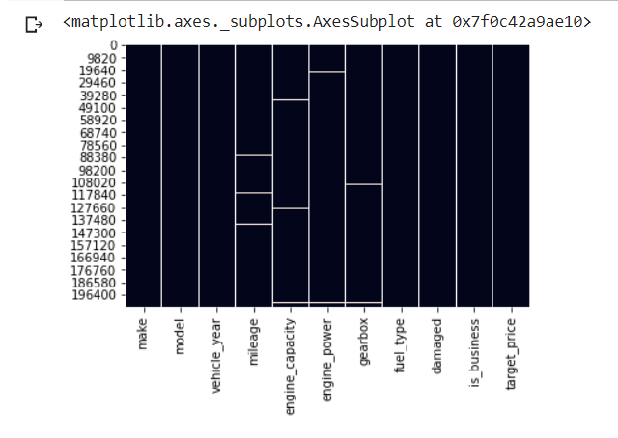
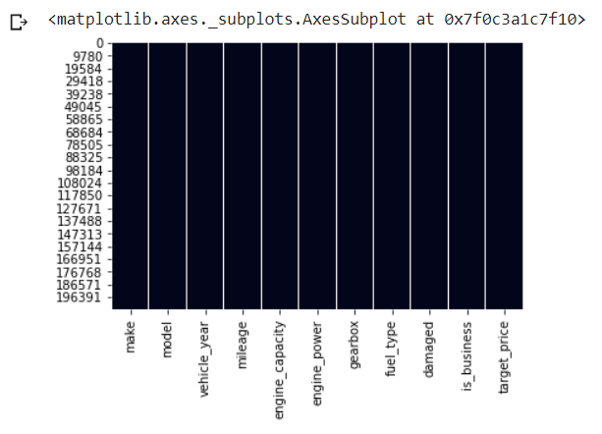
BASIC PRE-PROCESSING:
BEFORE REMOVING NULL VALUES
AFTER REMOVING NUL VALUES

Slide 8
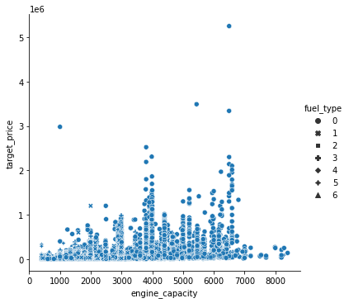
EXPLORATORY DATA ANALYSIS:
This graph implicates that for the fuel type “petrol” and a high engine capacity the target price will be the highest out of all.

Slide 9
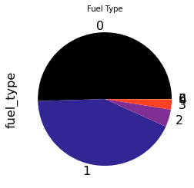
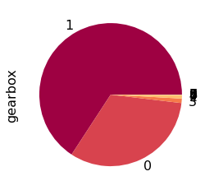
EXPLORATORY DATA ANALYSIS:
From first graph, Maximum number of people across all manufacturers preferred their car to have petrol fuel type followed by diesel and a very few groups preferred the other types .
Likewise , in second graph maximum people with a number higher than 120000 owned manual transmission vehicles .
Approx. half of that i.e. 60000 owned automatic transmission vehicles.

Slide 10
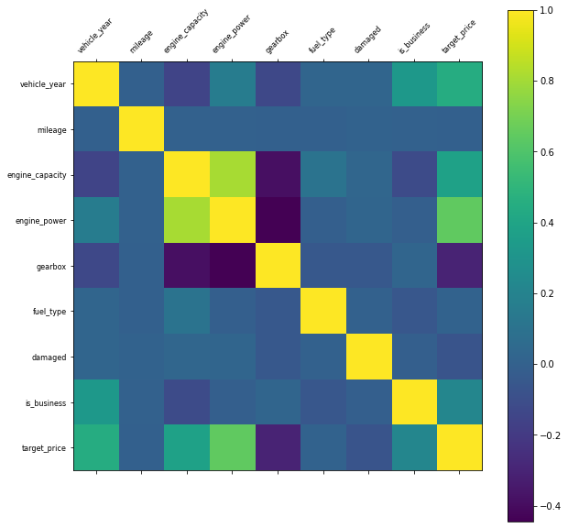
EXPLORATORY DATA ANALYSIS:
As you can probably see from the graphs the columns engine_capacity and engine_power are correlated to each other with a value of 0.8.
Thus we proceeded to remove either one of the columns to gauge the models.

Slide 11
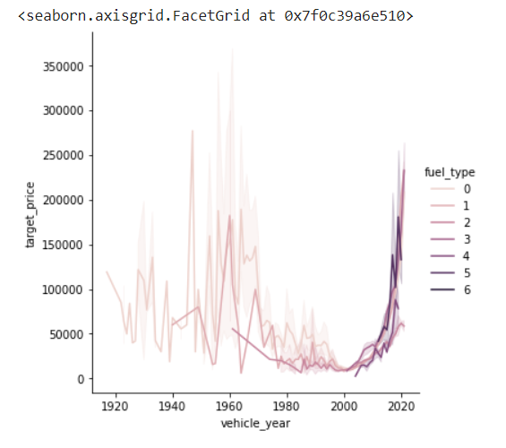
EXPLORATORY DATA ANALYSIS:
1917–2020
From 1917 to 2020 , we can see a gradual change in the fuel type trend.
2020
Earlier people relied much more on diesel and petrol cars but as we came to the year 2020 , due to various environmental factors people started preferring a much eco-friendlier option.

Slide 12
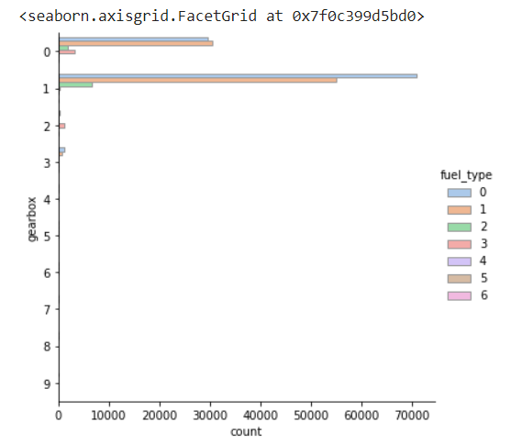
EXPLORATORY DATA ANALYSIS:
From this graph we can conclude that for a manual transmission vehicle people preferred diesel much more followed closely by petrol as their option.
But a reverse trend is seen for automatic transmission vehicles where people preferred petrol much more as compared to diesel fuel type.

Slide 13
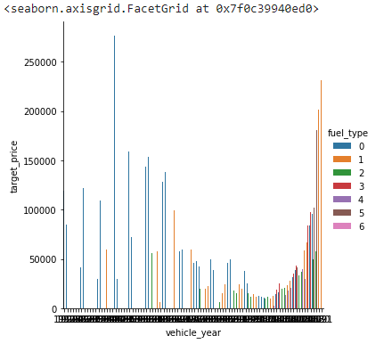
EXPLORATORY DATA ANALYSIS:
Initially from the year 1917 as petrol type was much more prevalent, it had the highest target price.
As the years went there were also various changes in the trend as now in the year 2020, the diesel fuel type is much more prevalent and has the highest target price.

Slide 14
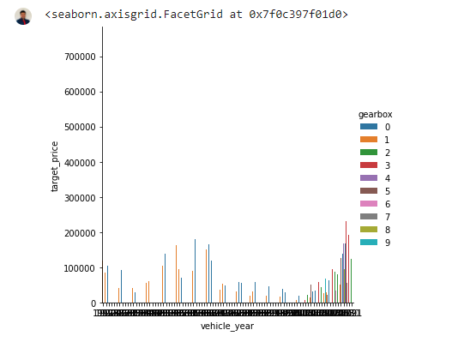
EXPLORATORY DATA ANALYSIS:
This graph informs us that gear box does not play a major role in increasing the price of a car as it can be seen that there were not many target prices that went above 200000.

Slide 15
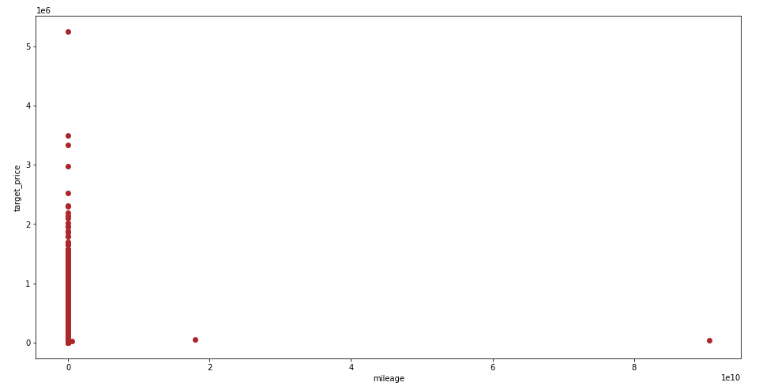
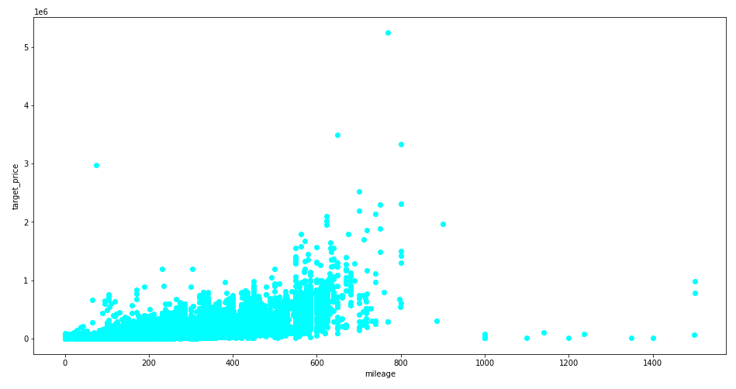
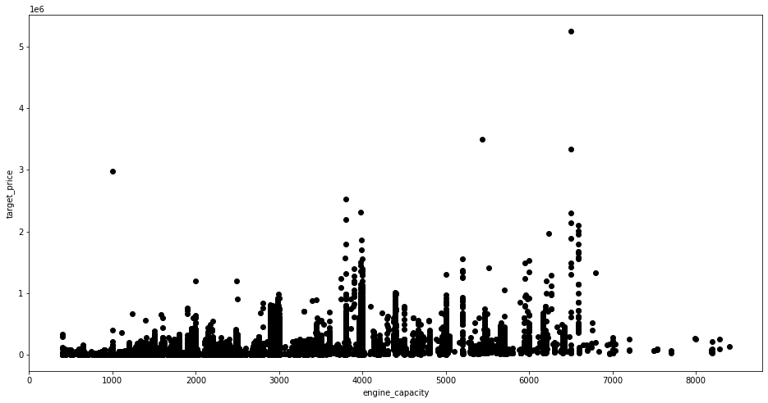
DETECTION AND REMOVING OUTLIERS:
These 3 scatter graphs tells us about the outliers that are present in the mileage column, engine capacity column and engine power column.

Slide 16
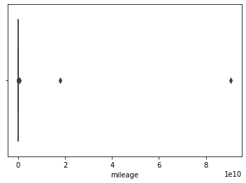
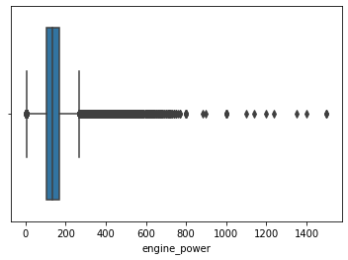
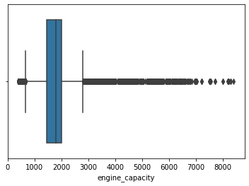
DETECTION AND REMOVING OUTLIERS:
The box plots give us a much more idea about how many number of outliers there are and help us to remove it .

Slide 17
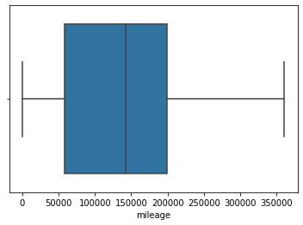
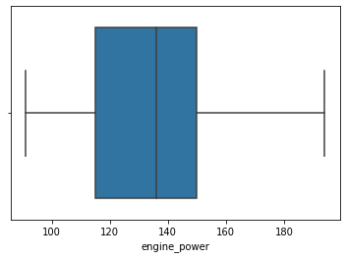
DETECTION AND REMOVING OUTLIERS:
As we previously discussed engine power column and engine capacity column were highly correlated to each other, we proceeded to use only engine power column for further analysis.
After detecting the outliers in the mileage and engine power column we removed them instead of replacing them with their median values as it could hamper the results.

Slide 18
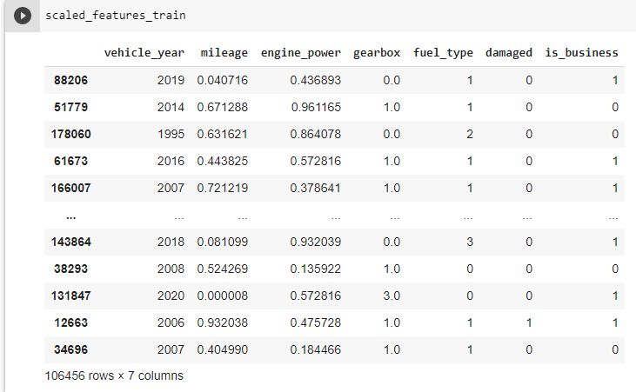
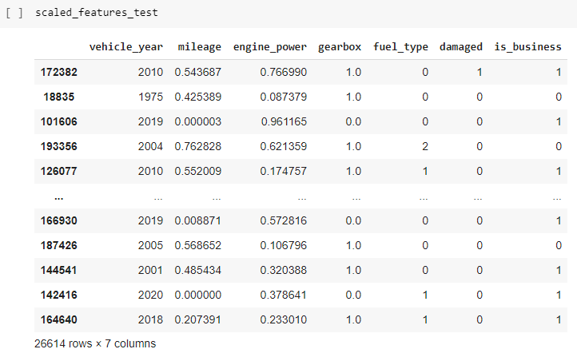
FEATURE SCALING:
We performed standard scaling on the data set to make it to a normal distribution.

Slide 19
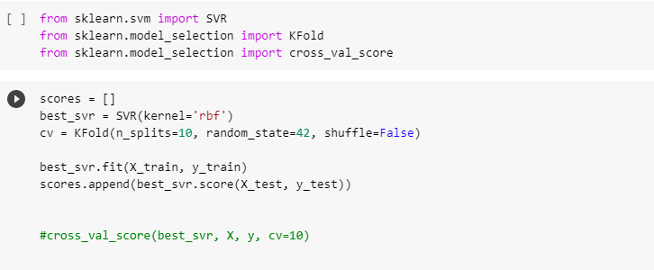
K-FOLD CROSS VALIDATION:
As this is a regression problem, k-fold cross validation was done to get the best cv score , but after repeated results not a higher range of accuracy was produced by SVR.

Slide 20
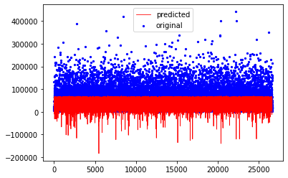
SUPPORT VECTOR REGRESSION:
R2 score of 0.39.

Slide 21
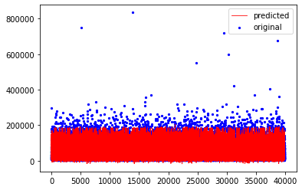
CONVOLUTIONAL NEURAL NETWORK(CNN):
R2 score of 0.813 .

Slide 22
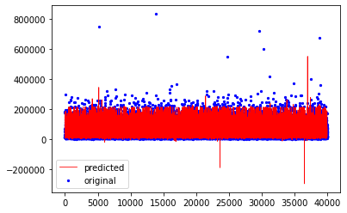
POLYNOMIAL REGRESSION:
R2 score of 0.85 .

Slide 23
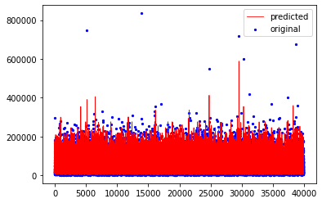
RANDOM FOREST REGRESSION :
R2 score of 0.87.

Slide 24
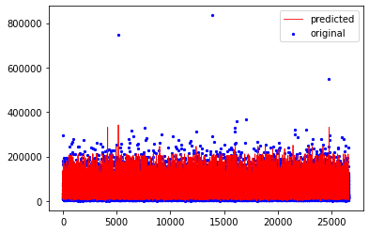
XG BOOST REGRESSION :
R2 score of 0.87.

Slide 25
MODEL PERFORMANCE :
MODEL | R2 SCORE | COMPUTATION TIME (Sec) | MAE | MSE | RMSE
SUPPORT VECTOR REGRESSION | 0.386 | 1328.94 | 0.421 | 0.611 | 0.781
CONVOLUTIONAL NEURAL NETWORK | 0.802 | 108.007 | 0.287 | 0.196 | 0.443
POLYNOMIAL REGRESSION | 0.866 | 2.69 | 0.212 | 0.132 | 0.364
RANDOM FOREST REGRESSION | 0.873 | 2.16 | 0.200 | 0.125 | 0.354
XG Boost Regression | 0.874 | 4.62 | 0.206 | 0.124 | 0.353

Slide 26
CONCLUSION
It is very apparent that Random forest regression is the best model for such a dataset .
Linear regression was not used as this dataset had high number of columns and simple regression methods cannot work here as you can probably see by looking at SVR.

Slide 27
FURTHER ACTIONS:
The make column and the model column were removed as it would not have played a role in regression analysis.
But , in real world a huge emphasis is given on the manufacturer and the model of the car and as such a tier system should be introduced were the top manufacturers and models should be placed in the topmost tier followed by the lower tier.
Also may be new column called distance_travel should be introduced that says about the distance in kilometres the car has travelled.

Slide 28

THANK YOU

